Slide 1
Analyzing Crime Rates by Group #3
Our project is to analyze crime rates per month. Our goal with this project is to be able to alert communities of when they should be more careful about their surroundings.
For example, more crimes happen during the Christmas season as people are away from their homes. People should be aware of this and try to secure their homes well during this season.
Members: Emely Seheon, Kritim Bastola, Steven Zuniga
Notes:
Emely (Everyone say Hi, don’t be rude.)

Slide 2
Data Source
We got our Dataset from Kaggle:
https://www.kaggle.com/datasets/ankkur13/boston-crime-data?resource=download
It contains data about crimes in Boston, Massachusetts from 2015 to 2018.
This dataset includes information about when, where, and what type of crime occurred. We are mainly focusing on when other crimes occurred to see if there is a pattern on when crimes can be expected. The information was gathered from the Boston Police Department.
Notes:
Emely

Slide 3
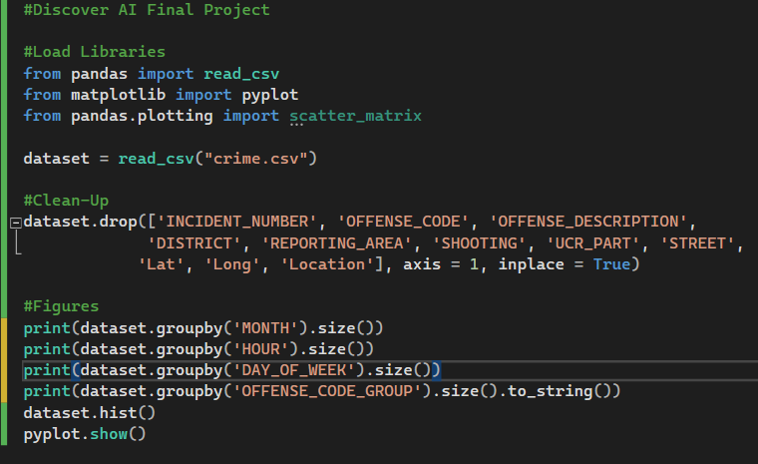
Code Implementation
This is the code that we used to produce our graphs.
We used the libraries
Pandas
Pandas Plotting
Matplotlib
Notes:
Emely

Slide 4
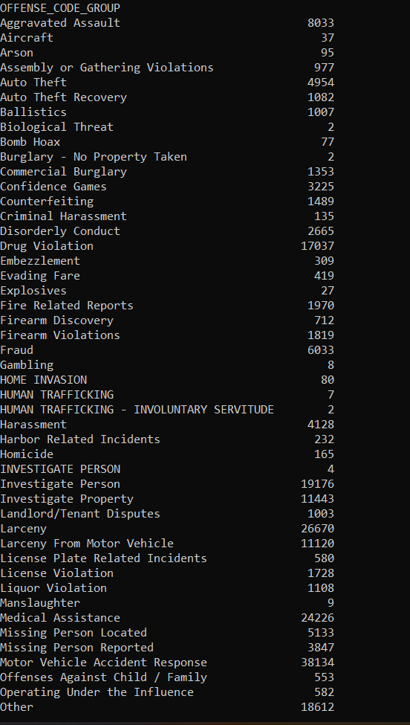
Takeaways From Dataset
We were able to separate the dataset into unique items, which were grouped into Offense Code Groups
The dataset contains 68 distinct different categories
There is a broad range of incident contacts in the dataset, ranging from the lowest value of 2 to 38,134
Issues to note:
These are just indication of an incident for a labeled offense reported to the law enforcement agency, they are not indication on the outcome of the incident.
Some of these offenses in the the offense grouping would not be an offense.
Examples: Medical Assistance, Missing Person Reported/Located, etc.
Notes:
Steven

Slide 5
Takeaways From Dataset
We were able to extract the monthly date range of the incidents in the dataset.
We can observe an upward trend of incidents in the summer months.
The dataset being used for the city of Boston there would be a lot of variable that we could use to cross reference the data. Variables being: summer cultural events like sports and festivals, school summer vacation, weather, daylight patterns, and tourism.
Notes:
Steven

Slide 6
Takeaways From Dataset
We were able to extract the hours of day when the incidents occurred.
We can observe a noticeable trend that shows an increase starting at the early morning and in the late afternoon.
We also observe that the highest level is grouped around business hours between the times of 0800 to 1800
There can be many variable that could influence these trends, the increased activity of people in public or the availability of law enforcement units.
Notes:
Steven

Slide 7
Takeaways From Dataset
We were able to extract the days of the week when the incidents reported occur.
We were not able to notice any distinct trends between different days of the week.
The exception being that Thursday was the day with the least amount of incidents reported.
Notes:
Steven

Slide 8
Algorithm
KNN or K-Nearest Neighbor Algorithm
KNN is a supervised machine learning algorithm, it is a method that estimates the likelihood that a data point will become a member of one group, or another based on what group data points nearest to it belong to.
With the dataset that we have, it will be very easy to lose control of the classification system for the offense. KNN algorithm can help mitigate this issue.
We could insert a preset list of labels that we are attempting to pursue and allow it to refine our dataset search.
The other method that we can implement KNN is if we were to map the list of incidents on a map of the city, we would be able to create connections that can help improve our results.
Notes:
Steven

Slide 9

Complexity of AI’s Impact
Notes:
Kritim

Slide 10
The Positive and Negative Impacts of AI
There could be bias in the dataset based on the location of the incidents that have occurred, certain neighborhoods may be more policed than others, but it might not represent the overall statistics accurately.
The skewed statistics may result in overcorrection in policing where certain neighborhoods may get more policing than necessary.
A positive impact would be that the statistics could help allocated resources more effectively, increasing efficiency.
Notes:
Steven

Slide 11
The Positive and Negative Impacts of AI
The issue can come up as to what the Law Enforcement Agency classifies as an incident.
If an AI becomes sophisticated enough to predict incidents, who would be responsible when a prediction that is ignored yet the incident does occur.
Alternatively, if there is a false positive causing someone to be incriminated unfairly.
Notes:
Steven

Slide 12
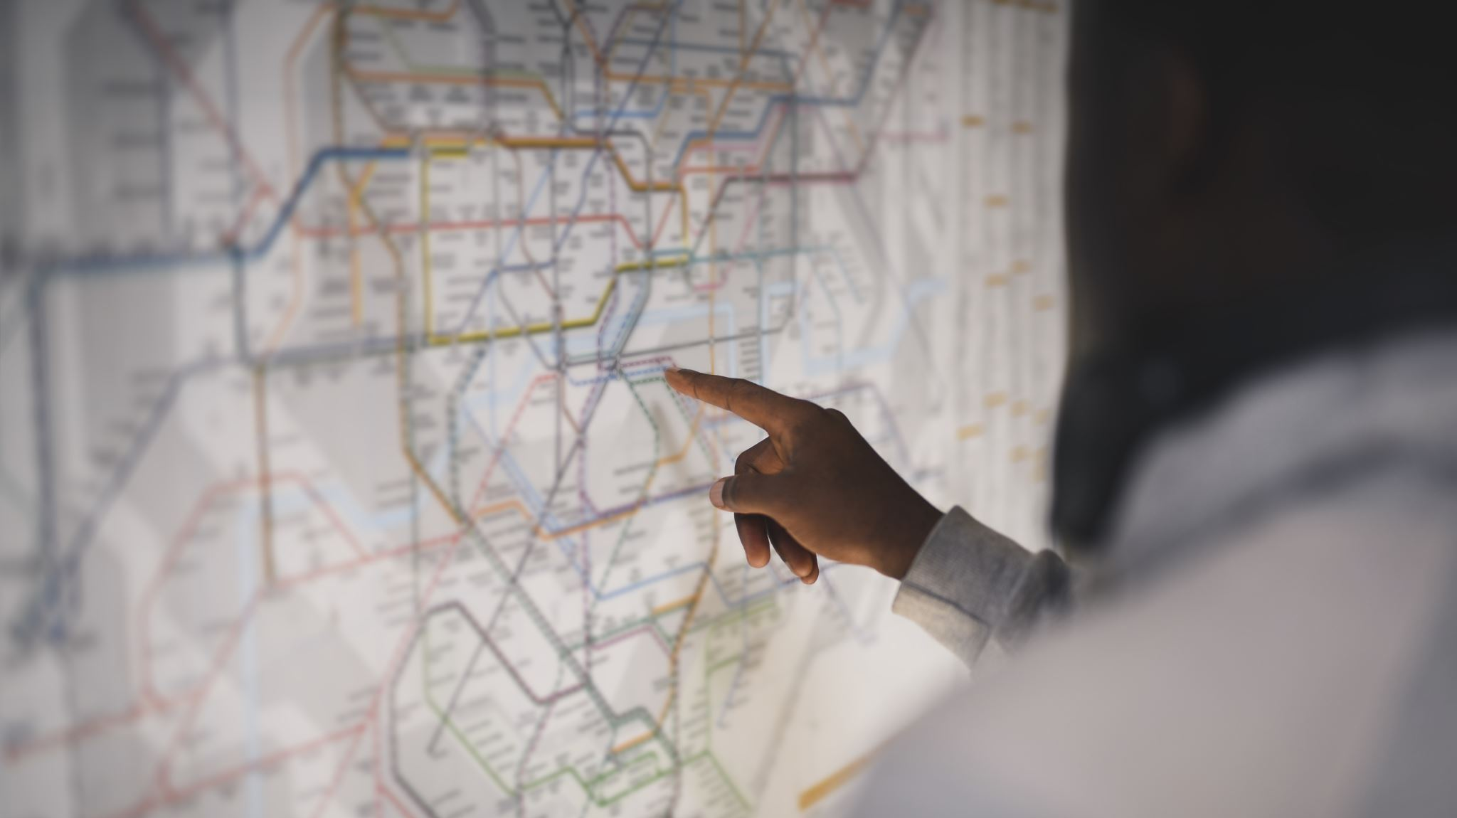
At which Scope and Sector, the AI could be used in the current state?
At this stage, This AI can be used by local-level police departments to predict crimes and crime rates at a particular time of the year.
Since it can give output as graphs and charts it can be used to prepare reports of crimes that happened in a particular period of time.
Notes:
Kritim

Slide 13

WHAT IS THE FUTURE FOR THIS AI.
Right now, it only works to predict what kind of crimes may happen at a certain period of time.
It can be further developed to predict what kind of behavior in people leads to what kind of crimes at a particular time.
It can also be developed to predict what kind of people are more prone to certain crimes.
This AI have a lot of room for further development.
Notes:
Kritim

Slide 14

What challenges We might face to take this AI to next level?
Of course, to train any AI we need data, and getting data is not easy.
Since this AI uses crime data, if we want to develop it further, we might have to get data from the police department and the government itself.
We will also need to have more knowledge of python libraries if we want to have additional features that are not taught in this class
Notes:
Kritim

Slide 15
Next Step
Notes:
Kritim

Slide 16
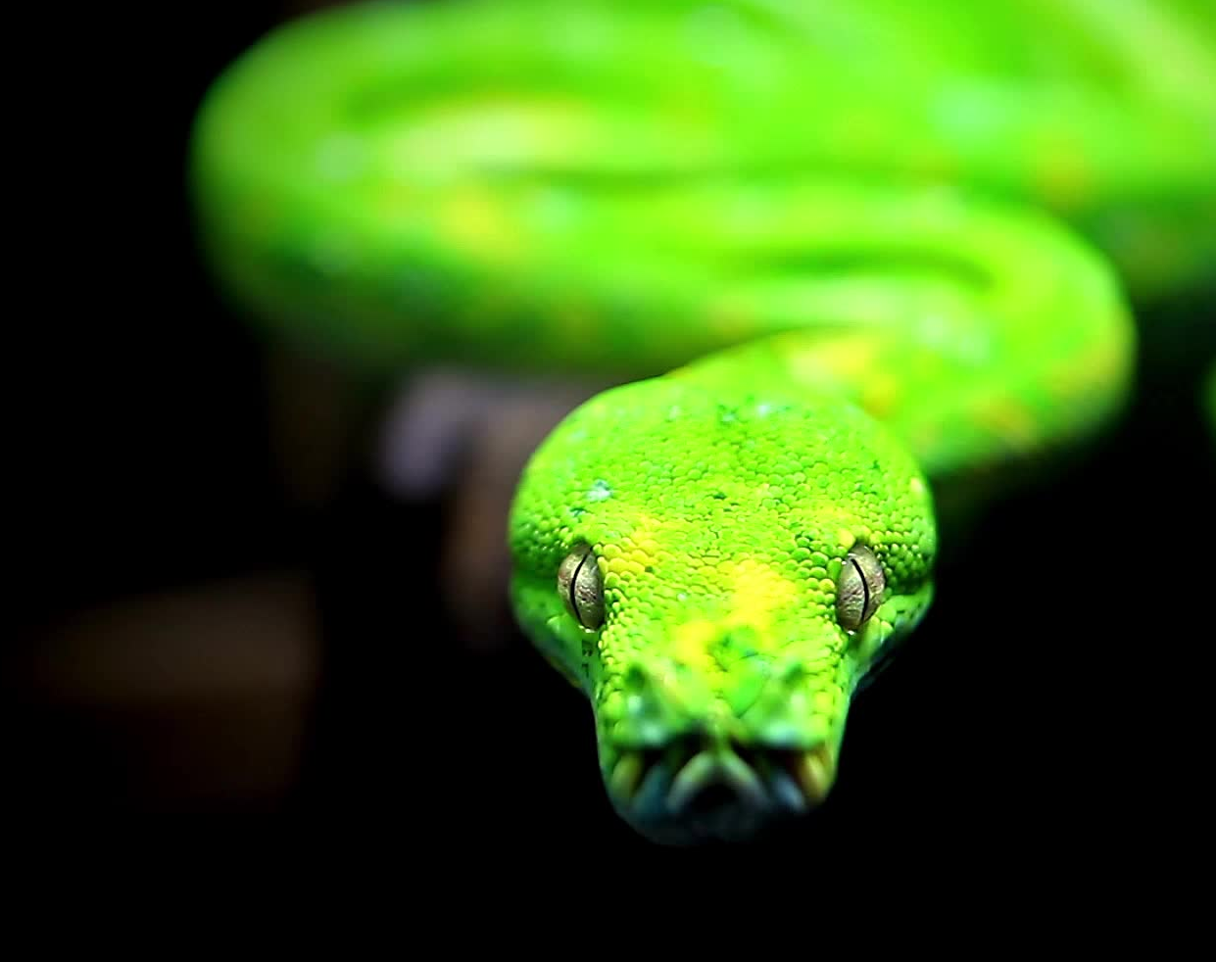
Learn more Python libraries
AI uses a lot of libraries function to get its job done and it is necessary that we learn more of python libraries associated with AI to learn more aspects of AI
Notes:
Kritim

Slide 17
ML theories
The things we have learned here in this course are limited and there are much more things to cover. We should start by learning more ML theories before getting started on coding because without the knowledge on how certain things work in some way we will not be able to code it.
Notes:
Kritim

Slide 18
Focus on Statistics
One thing that I have felt from taking this course is AI and ML use a lot of mathematical stuff, especially Statistics. Of course pure maths is needed here but I have felt statistics is the key thing to gaining mastery in AI and ML.
Notes:
Kritim

Slide 19
Develop the project you have presented on.
We have prepared what and how our program (AI) is going to work but this is the ground state of our program. There can be further improvement in our program. So, even after the course is over we should still communicate with our team-mates and try to make some improvements and adjustments in the program.
Notes:
Kritim

Slide 20
Conclusion
Using python libraries and the dataset from Kaggle, we were able to find patterns at which incidents occurred at specific times.
Using KNN Algorithm, we may be able to improve classification labels on the dataset or use it in mapping situation to create a more effective visual analysis.
There are multiple ethics issues that come up when using AI/ML for situation in policing.
AI/ML can also help agencies become more prepared and use their resources more effectively with the benefit of them and the population.
Notes:
Steven( Everyone say Thank you!)

